Slide 1
BB[α] trees

Slide 2
Outline
This topic will
Define
Null sub-trees
Weight Balance
Introduce weight balance
Define bounded-balance BB(α) trees
Compare weight and height balance

Slide 3
Background
Topic 5.5 Balanced trees discussed various schemes for defining balance in trees
AVL trees are height-balanced
Is it possible to consider the ratio of the nodes in each sub-tree?
Ensure that the ratio between the nodes in the left and right sub-trees does not grow too large

Slide 4
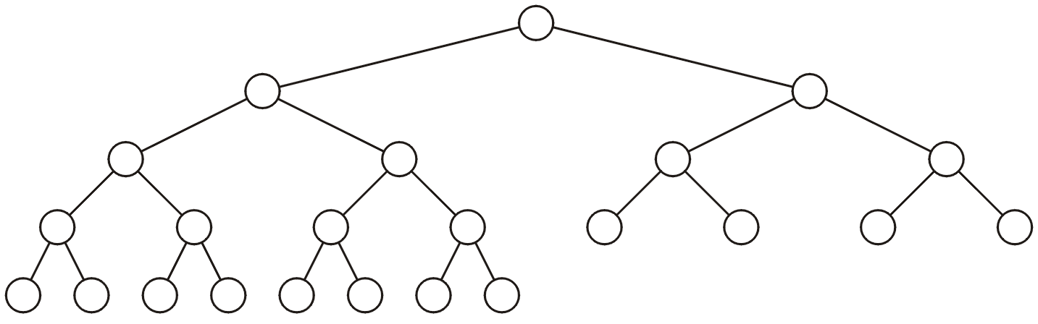
Background
In this example, the ratio is 15:7

Slide 5
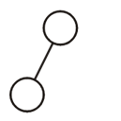
Background
Here’s a tree that must be considered acceptable, but 100 % of the nodes are in the left sub-tree

Slide 6
Background
Thus, we need a slight different metric
We will define null sub-trees
Weight balancing will be based on the number of null sub-trees
Notes:
6

Slide 7
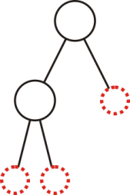
Null sub-tree
A null sub-tree as any location where a leaf node may be inserted
This tree with n = 2 nodes has three null sub-trees
An empty tree (n = 0) has one null link

Slide 8
Null sub-tree
Theorem
A binary tree with n nodes has n + 1 null sub-tree
Proof
True for n = 0: it has one null sub-tree
Assume it is true for all trees with less than or equal to n nodes
A tree with n + 1 nodes has two sub-trees:
As n_{L} + n_{R} = n, it follows n_{L} ≤ n and n_{R} ≤ n
By assumption, both sub-trees have n_{L} + 1 and n_{R} + 1 null sub-trees
Thus, the total number of null sub-trees is (n_{L} + 1) + (n_{R} + 1) = (n_{L} + n_{R}) + 2 = n + 2

Slide 9
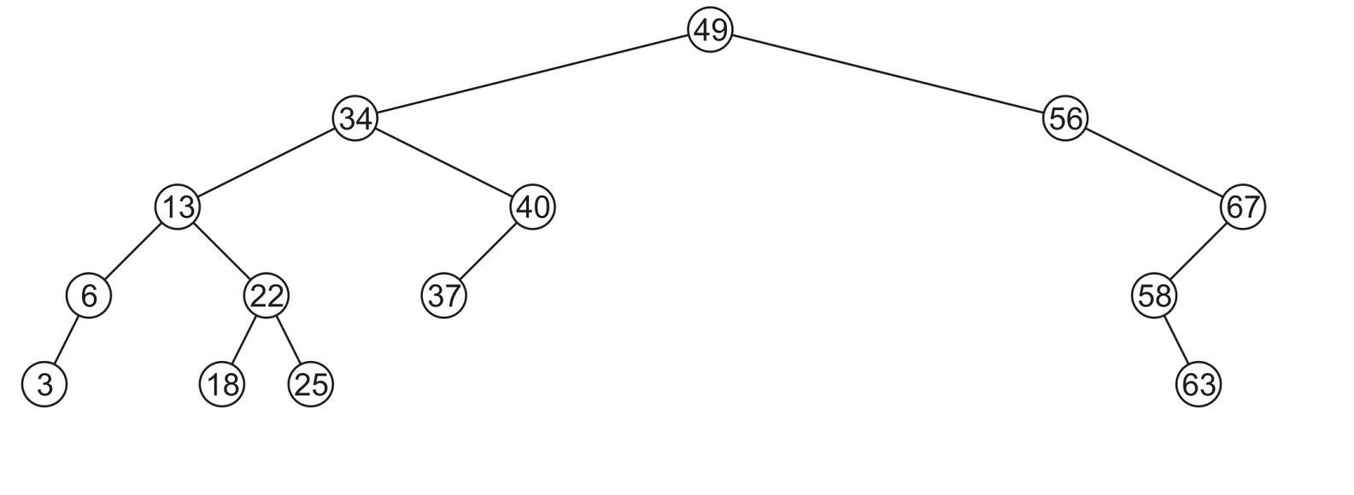
Null sub-tree
This binary search tree with n = 14 nodes

Slide 10
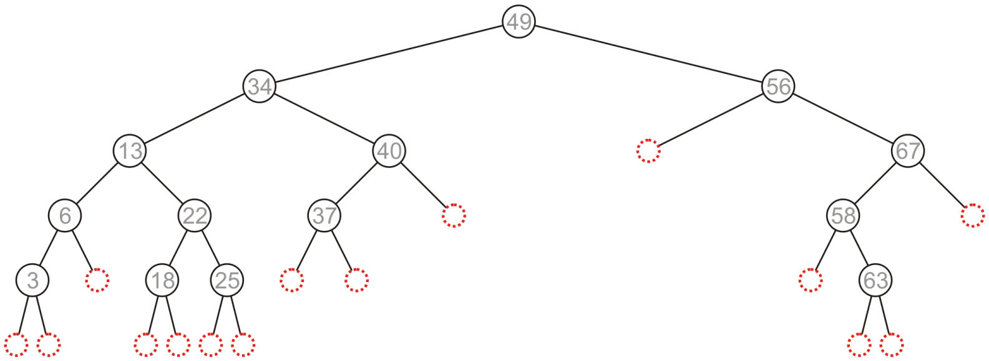
Null sub-tree
This binary search tree with n = 14 nodes and 15 null sub-trees
In our Binary_search_node class, any sub-tree assigned nullptr is represents a null sub-tree

Slide 11
Weight balance
The weight balance ρ of a tree is the ratio of null sub-trees in the left sub-tree over the total number of null sub-trees
For a tree with n nodes
double Binary_search_node<Type>::weight_balance() const {
if ( empty() ) {
return NAN;
}
double nst_left = static_cast<double>( left()->size() + 1.0 );
double nst_right = static_cast<double>( right()->size() + 1.0 );
return nst_left / (nst_left + nst_right);
}

Slide 12
Weight balance
Here, ρ = 10/15 ≈ 0.667

Slide 13
Weight balance
The balance of a tree depends on ρ
ρ ≈ 0 right-heavy node
ρ ≈ 0.5 approximately balanced node
ρ ≈ 1 left-heavy node

Slide 14
BB(α) trees
A BB(α) tree requires that all nodes have bounded weight balance of
α ≤ ρ ≤ 1 – α
where 0 ≤ α ≤ ½

Slide 15
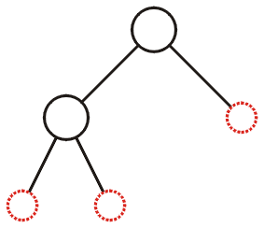
BB(α) trees
Is it possible to construct a BB(½) tree?
This weight has ρ = ⅔
Only perfect trees are BB(½) trees
Use proof by induction on the height
ρ = ⅔
ρ = ½

Slide 16
BB(α) trees
As with AVL trees, rotations will correct the balance
Insertions with AVL trees require at most one rotation
More than one rotation may be necessary for BB(α) trees

Slide 17
BB(α) trees
By restricting it can be shown that both the height is Θ(ln(n)) and the number of required rotations an amortized Θ(1)

Slide 18
BB(α) trees
With our restriction, a BB(α) tree is bounded by
It follows that:
α = 0.5: h ≤ lg(n + 1)
α = 0.25:

Slide 19
BB(α) trees
With our restriction, any sequence of m insertions into an initially empty BB(α) tree will require O(m) AVL-like rotations
This gives an amortized Θ(1) rotations per insertion
If a node becomes unbalanced as a result of an insertion, only one rotation is required to balance it

Slide 20
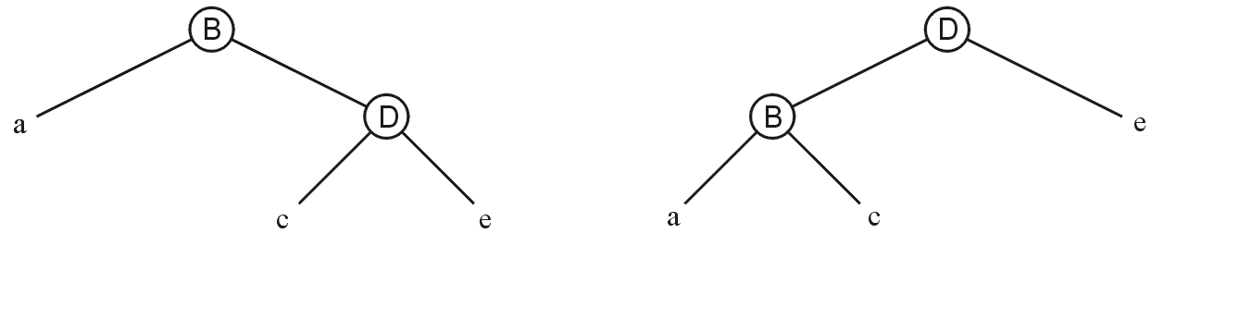
BB(α) trees
First rotation:
Writing σ_{B} and σ_{D} in terms of ρ_{B} and ρ_{D}
Notes:
This can be found with Maple
solve( {pB = a/(a+c+e), pD = c/(c + e)}, {a, c, e} );
# {c = -pD*(pB-1)*a/pB, e = (pD-1)*(pB-1)*a/pB, a = a}
eval( {sB = a/(a+c), sD = (a+c)/(a+c+e)}, % );
# {sB = a/(a-pD*(pB-1)*a/pB), sD = (a-pD*(pB-1)*a/pB)/(a-pD*(pB-1)*a/pB+(pD-1)*(pB-1)*a/pB)}
simplify(%, size);
# {sD = pB-pD*pB+pD, sB = -pB/(-pB+pD*pB-pD)}
20

Slide 21
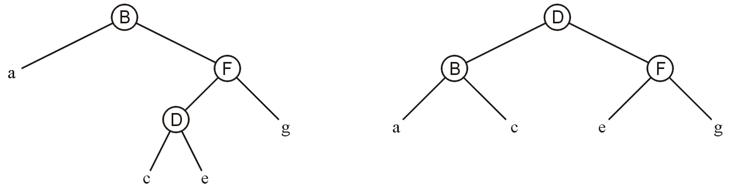
BB(α) trees
Second rotation:
Writing σ_{B}, σ_{D} , σ_{F} in terms of ρ_{B}, ρ_{D} , ρ_{F}
Notes:
From Maple:
solve( {pB = a/(a+c+e+g), pD = c/(c+e), pF = (c+e)/(c+e+g)}, {a, c, e, g} );
# {a = a, g = 1/pB*(pF*pB-pF-pB+1)*a, c = -a*(pB-1)*pF*pD/pB, e = (pD-1)*a*(pB-1)*pF/pB}
eval( {sB = a/(a+c), sD = (a+c)/(a+c+e+g), sF = e/(e+g)}, % );
# {sD = (a-a*(pB-1)*pF*pD/pB)/(a-a*(pB-1)*pF*pD/pB+(pD-1)*a*(pB-1)*pF/pB+1/pB*(pF*pB-pF-pB+1)*a), sF = (pD-1)*a*(pB-1)*pF/pB/((pD-1)*a*(pB-1)*pF/pB+1/pB*(pF*pB-pF-pB+1)*a), sB = a/(a-a*(pB-1)*pF*pD/pB)}
simplify(%, size);
# {sD = (-pF*pB+pF)*pD+pB, sF = (pD-1)*pF/(pF*pD-1), sB = -pB/(-pB+pF*pD*pB-pF*pD)}
21

Slide 22
BB(α) trees
As α → 1/3
The tree is very balanced
Imbalances cannot be corrected with simple AVL-like rotations while recursing back to the root
As α → 0
The tree is unbalanced
The height is O(n)

Slide 23
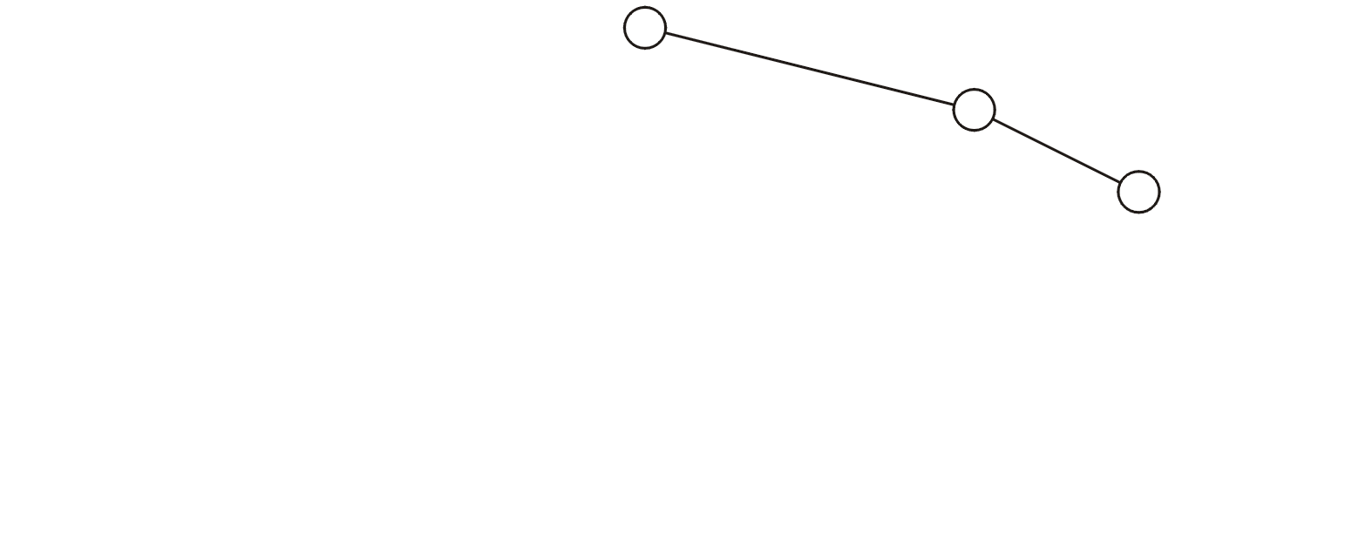
Worst-case BB(¼) Trees
A worst-case BB(¼) tree
ρ = 1/4

Slide 24
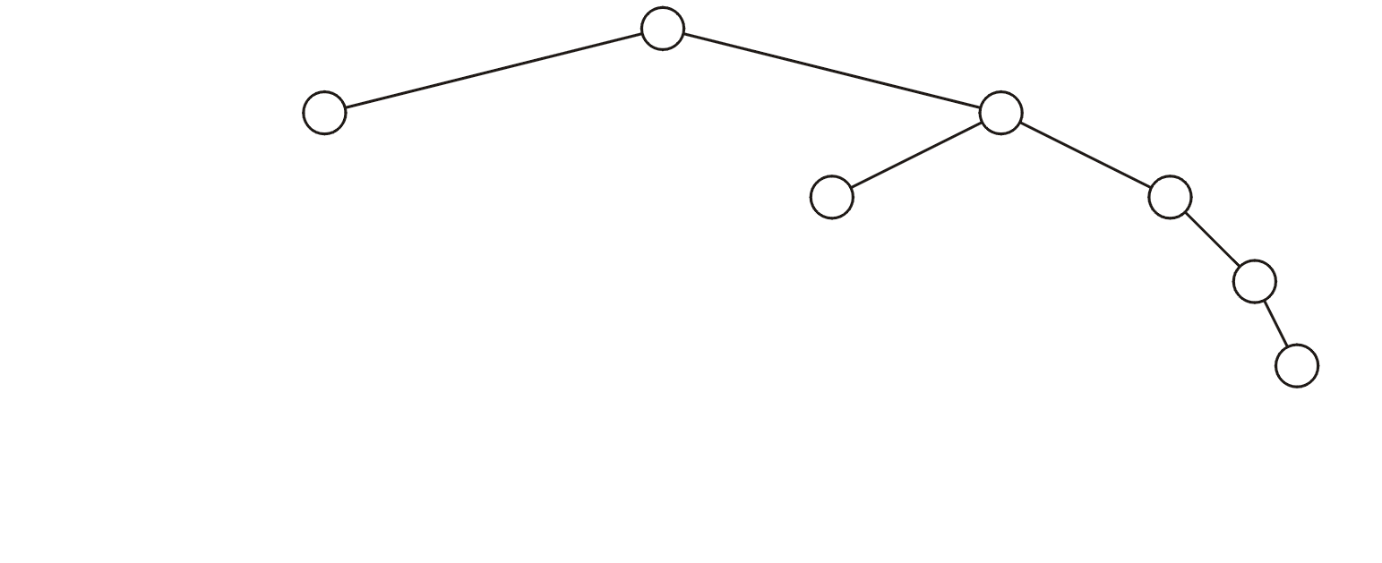
Worst-case BB(¼) Trees
A worst-case BB(¼) tree
ρ = 2/8

Slide 25
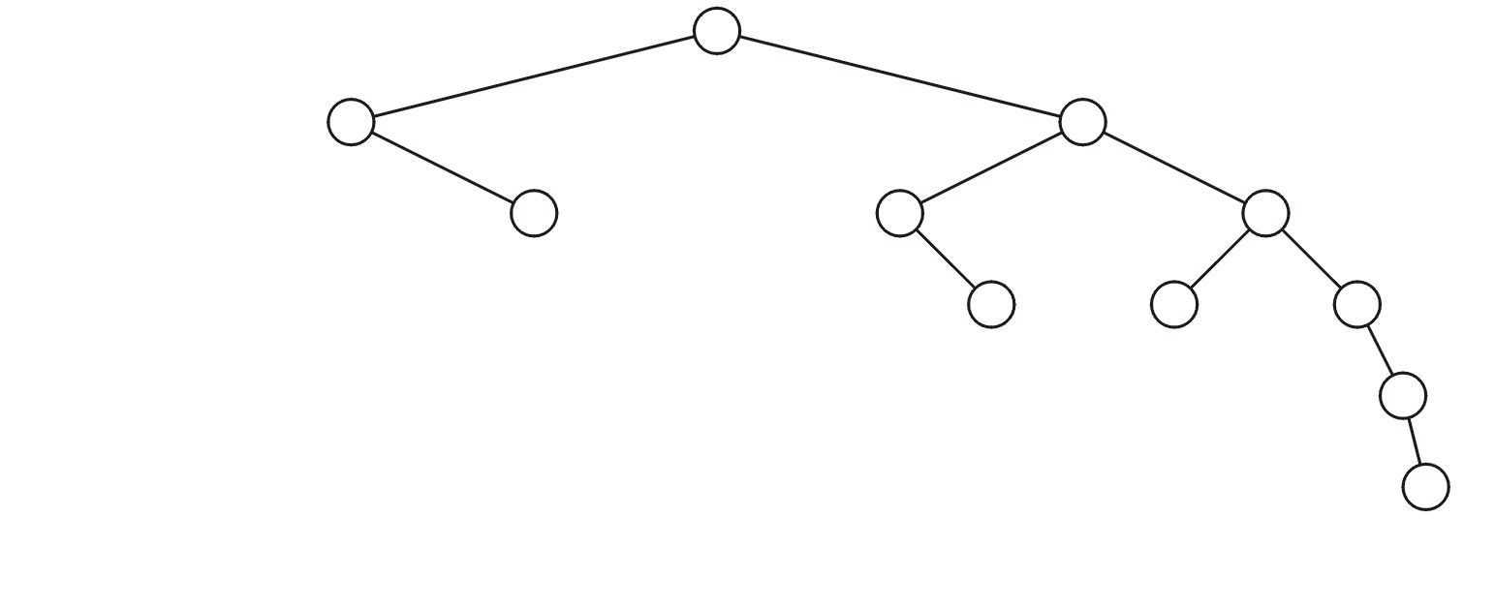
Worst-case BB(¼) Trees
A worst-case BB(¼) tree
ρ = 3/12

Slide 26
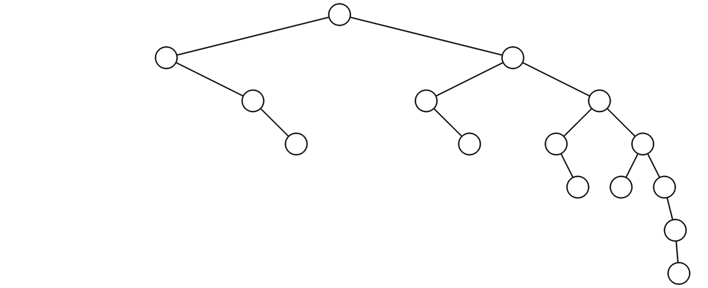
Worst-case BB(¼) Trees
A worst-case BB(¼) tree
ρ = 4/16

Slide 27
Weight versus Height Balance
Is every AVL tree a BB(α) tree?
Consider an AVL tree of height h with
A worst-case AVL left sub-tree of height h – 2
A perfect right sub-tree of height h – 1

Slide 28
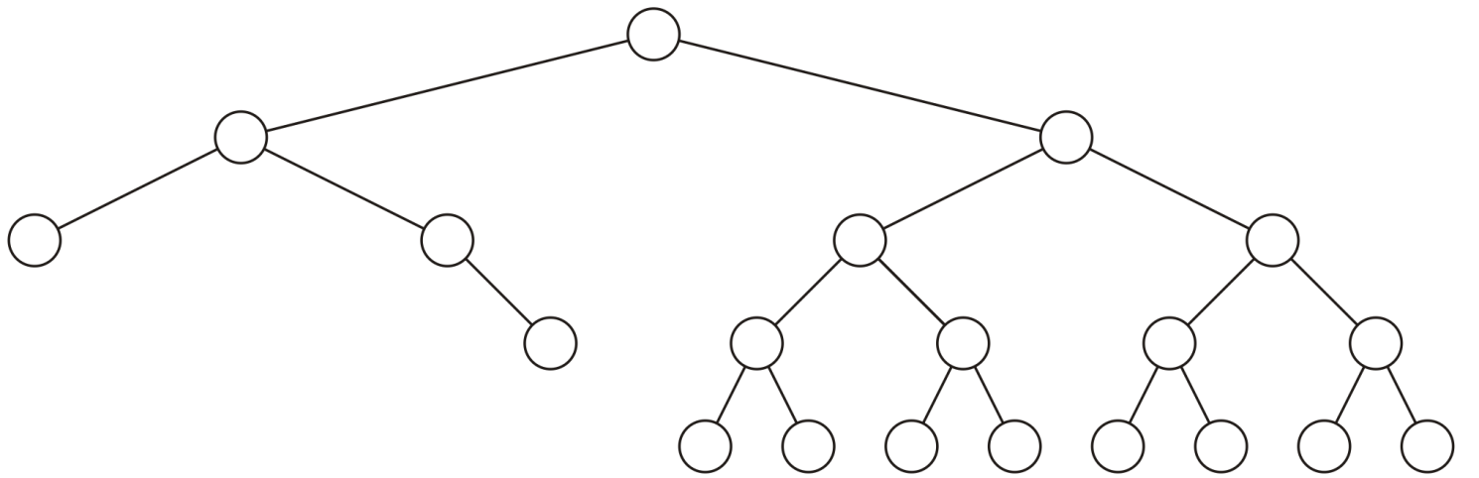
Weight versus Height Balance
A worst-case weight-imbalanced AVL tree with
h = 4 and ρ = 5/21 = 0.238 < 0.25

Slide 29
Weight versus Height Balance
The number of nodes in
The worst-case AVL tree is Θ(φ^{h})
A perfect tree is Θ(2^{h})
Therefore ρ = Θ((φ/2)^{h}) where φ/2 ≈ 0.809
That is, ρ → 0 as h → ∞
Notes:
This can be easily seen in Maple where the limit of the ratio appears to be .7236067977499789696409173…
# number of nodes in a worst-case AVL tree of height h
worst := unapply( rsolve( {F(0) = 1, F(1) = 2, F(h) = F(h - 1) + F(h - 2) + 1}, F(h) ) + 1, h ):
# number of nodes in a perfect tree of height h
best := h -> 2^(h + 1) - 1 + 1:
# calculation of rho
rho := unapply( worst(k - 2)/(best(k - 1) + worst(k - 2)), k ):
phi := (sqrt(5) + 1)/2:
Digits := 40:
for h from 1 to 10 do
print( h, evalf( rho(h), 6 ), evalf( rho(h) / (phi/2)^h ) );
end do:
# 1, .333333, .4120226591665965654697245562437587451467
# 2, .333333, .5092880150001402023938842208458158430394
# 3, .272727, .5150574054540866103472880045046026955064
# 4, .238095, .5558020333345350681380552262974691308151
# 5, .200001, .5770876399966351425467786997004197670491
# 6, .168832, .6021528685805180564970133826274375123841
# 7, .140942, .6213402877605743332958546313614656752907
# 8, .117243, .6388806908248967785268967838317320365888
# 9, .970030e-1, .6533724668418403262779871164665951148715
# 10, .799643e-1, .6657610700153380696069941409939332338745
for i from 1 to 5 do
h := 10^i;
print( h, evalf( rho(h), 6 ), evalf( rho(h) / (phi/2)^h ) );
end do:
# 10, .799643e-1, .6657610700153380696069941409939332338745
# 100, .452208e-9, .7236067974228117866790205338087495598899
# 1000, .657465e-92, .7236067977499789696409173668731276233329
# 10000, .277556e-920, .7236067977499789696409173668731276214303
# 100000, .513414e-9204, .7236067977499789696409173668731276024035

Slide 30
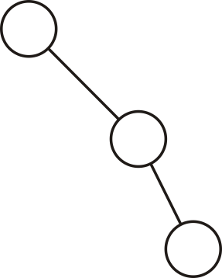
Weight versus Height Balance
Is every BB(α) tree an AVL tree?
Consider this BB(1/3) tree

Slide 31
Summary
This topic
Defined null links and weight balance
Introduce weight balance
Define BB(α) trees
Compared weight and height balance
Neither is a subset of the other

Slide 32
References
Roger Whitney, San Diego State University, Lecture Notes
http://www.eli.sdsu.edu/courses/fall95/cs660/notes/BB/BBtrees.html

Slide 33
Usage Notes
These slides are made publicly available on the web for anyone to use
If you choose to use them, or a part thereof, for a course at another institution, I ask only three things:
that you inform me that you are using the slides,
that you acknowledge my work, and
that you alert me of any mistakes which I made or changes which you make, and allow me the option of incorporating such changes (with an acknowledgment) in my set of slides
Sincerely,
Douglas Wilhelm Harder, MMath
dwharder@alumni.uwaterloo.ca

